Slide 1
Recurrent Neural Network
Able Gurung
Himal Basnet

Slide 2
AGENDA
Introduction
Architecture
Working & Drawbacks
Application
Future Development

Slide 3
INTRODUCTION
Recurrent Neural Networks (RNNs) are a type of neural network designed to process sequential data
RNNs have a "memory" that allows them to maintain information from previous time steps.
The basic structure of an RNN includes a recurrent hidden layer that performs computations at each time step and maintains the memory of the network.
RNNs can be used for natural language processing, speech recognition, language translation, time series forecasting and more.
RNNs are capable of handling sequential data with varying lengths, unlike traditional feedforward neural networks.

Slide 4
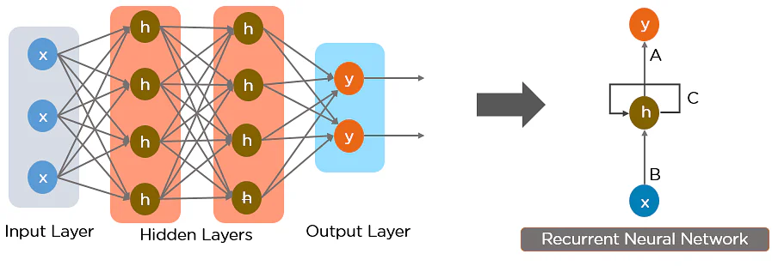
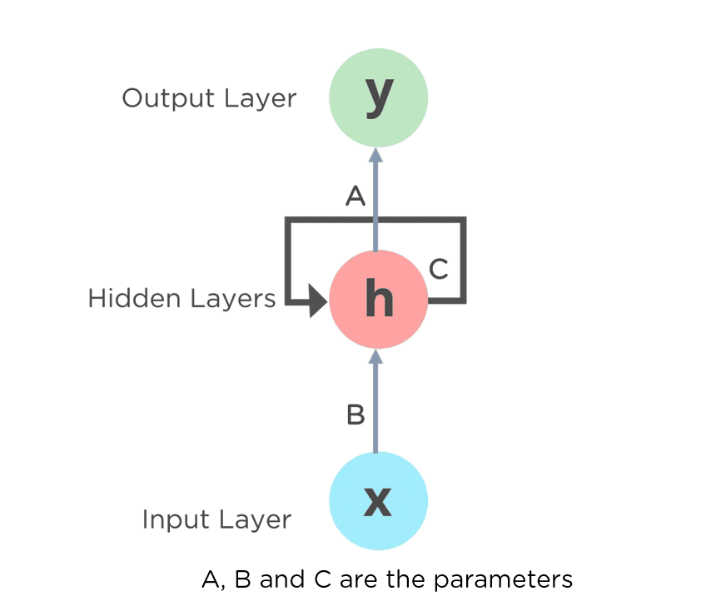
Architecture of Recurrent neural network
Fig 1.: Simple Recurrent Neural Network
Fig 1.1: Fully connected Recurrent Neural Network

Slide 5

Working of RNN
Fig 1.3: Working of Recurrent Neural Network

Slide 6
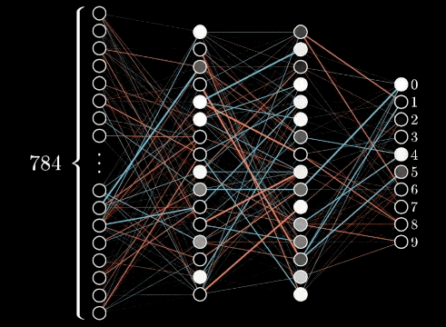
Drawback of RNN
Fig 2 : Vanishing and Exploding Gradient Problem

Slide 7
Applications of Recurrent Neural Network
Music Generation
Speech Recognition
Video Analysis
Time Series forecasting
Natural Language Processing
Language Translation

Slide 8
Future Development
Better Attention & Memory
Long Short-Term Memory (LSTM) & GRU
Allows the model to focus on specific parts of the input when making predictions.
This can be useful for tasks such as machine translation, where the model needs to be able to focus on different words in the input sentence depending on the context. ​
Can handle input sequences of varying lengths and maintain long-term dependencies
​Use of gates to control the flow of Information
Use of memory cells

Slide 9
References & Review
Article & Visuals:
www.simplilearn.com/tutorials/deep-learning-tutorial/rnn
Examples:
https://www.youtube.com/watch?v=LHXXI4-IEns&t=198s
REVIEWED BY:
Diwang Mahat
Kritita Shrestha
Bibek Karki
Rakesh Rai
2023
Recurrent Neural Network
9

Slide 10
THANK YOU
Able Gurung
Himal Basnet

